Slide 1
RLL-Project Demo-Web-Shop .Tricentis .Com
Group-3
http://demowebshop.tricentis.com

Slide 2
RLL-GROUP-3
Emp Id | NAME
2583815 | Shivanshu Mishra [Leader]
2583187 | Yellammagari Madhu
2583035 | Mandaloju Amulya
2583265 | Kalva Prasanthi
2583600 | Akshata Basutkar
2583152 | Supriya B C
2583098 | R Raagul

Slide 3
Agenda
01.
02.
03.
04.
Introduction
Objectives
Modules
Test Scenario
05.
06.
screenshots
Technologies Used
07.
Conclusion

Slide 4
INTRODUCTION

Slide 5
In this project we are testing the functionalities of the website:
https://demowebshop.tricentis.com/
Here we have given the importance about automation in testing scenarios with the help of Excel to read data.
The tools and Framework which we have worked here are: Java, Selenium WebDriver, TestNG, Jenkins (optional), Cucumber-Java.
Project Objectives are to Create a test script for automation and generate reports for the e-Commerce website on efficiency and reliability in testing.
For the failed test cases we have used IRetry Analyser and screenshots for capturing the failed test cases

Slide 6
OBJECTIVES

Slide 7
Automation is a key focus of the project for testing scenarios on the Demo Web Shop website.
The project emphasizes the use of Excel for data-driven testing. Test scripts are designed to read data from Excel files, allowing for flexible and extensive testing scenarios.
The primary objective is to create effective and efficient test scripts using the specified tools and frameworks.
The project aims to generate comprehensive reports to evaluate the efficiency and reliability of testing on the Demo Web Shop website.
Cucumber-Java is used, indicating a focus on Behavior-Driven Development (BDD) principles. This involves creating readable and understandable test scenarios in natural language.
The primary goal is to assess the efficiency and reliability of the testing process, ensuring that the automated scripts effectively verify the functionality of the Demo Web Shop website.

Slide 8
MODULES
Register
Login
Add/Remove product to Cart
Add/Remove product to Wishlist
Checkout
Search
Community Poll
Newsletter Subscription

Slide 9
TEST
SCENARIO

Slide 10
1.Register
To test new registration with valid registration
To test new registration with empty fields
To test new registration with mismatch password
To test new registration with already registered email
To test new registration with weak password
2.Login
User Should Click and Provide the valid user ID and valid password.
User Should Click and Provide the invalid user ID and valid password.
User Should provide invalid email and invalid password.
User should submit blank credentials.
3.Add/Remove product to cart
Confirm whether all books having Add To Cart button or not.
Add the third book from book menu into the cart.
Add any three products into card, deleting any two products from cart.
Validate the cart after deleting the products.

Slide 11
4.Add/remove From Wish List
Log in and Click on "Digital Downloads“.
Go to the Wishlist.
Remove a product from the Wishlist.
5.Checkout
Confirm billing address and click continue.
Confirm shipping address and click continue.
Add shipping method and click continue.
Add payment methods and click continue.
Payment information and click continue.
Check the order confirmation.
6.Search
Search without entering text.
Test specific category searches.
Check valid name searches.
Validate system's synonym and typo handling.

Slide 12
7.Community Poll
To verify that the user can perform Community Poll by login
To verify that existing user can perform Community Poll by login
To verify that the user can perform Community Poll without login
To verify that the user can perform Community Poll by directly clicking on vote
8.Newsletter Subscription
Verify that user can subscribe to newsletter with valid Email id.
Verify that user can subscribe to newsletter with invalid Email id format.
Verify that user can subscribe to newsletter with blank Email id.

Slide 13
TECHNOLOGIES USED

Slide 14
SELENIUM
Selenium is an open-source, automated testing tool used to test web applications across various browsers.
Selenium can test web applications against various browsers like Firefox, Chrome, Opera, and Safari.
Tests can be coded in several programming languages like Java, Python, Perl, PHP, and Ruby.
Selenium is platform-independent, meaning it can deploy on Windows, Linux, and Macintos.
Selenium can be integrated with tools like JUnit and TestNG for test management.

Slide 15
Importance of Testing in Selenium:
Language Support: Selenium allows us to create test scripts in different languages like Ruby, Java, PHP, Perl, Python, JavaScript, and C#, among others.
Browser Support: Selenium enables us to test our website on different browsers such as Google Chrome, Mozilla Firefox, Microsoft Edge, Safari, Internet Explorer, etc.
Scalability: Automated testing with Selenium can easily scale to cover a wide range of test case, scenarios, and user interactions.
Reusable Test Scripts: Selenium allows testers to create reusable test scripts that can be used across different test cases and projects. This reusability saves time and effort in test script creation and maintenance.
Parallel Testing: Selenium supports parallel test execution, allowing multiple tests to run concurrently. This helps reduce the overall testing time, making the development process more efficient.

Slide 16
6.Documentation and Reporting: Selenium provides detailed test execution logs and reports, making it easier to track test results and identify areas that require attention.
7.User Experience Testing: Selenium can simulate user interactions and behavior, allowing testers to assess the user experience and ensure that the application is user-friendly.
8.Continuous Integration and Continuous Deployment (CI/CD): Selenium can be integrated into CI/CD pipelines to automate the testing of each code change.
Components of Selenium :
Selenium IDE
Selenium RC
Selenium WebDriver
Selenium Grid

Slide 17
POM
A Project Object Model or POM is the fundamental unit of work in Maven.
It is an XML file that contains information about the project and configuration details used by Maven to build the project.
The pom.xml file contains information of project and configuration information for the maven to build the project such as dependencies, build directory, source directory, test source directory, plugin, goals etc.

Slide 18
Requirement for a POM are:
modelVersion - should be set to 4.0.0
groupId - the id of the project's group.
artifactId - the id of the artifact (project)
version - the version of the artifact under the specified group.
Here's an example:
<project>
<modelVersion>4.0.0</modelVersion>
<groupId>com.mycompany.app</groupId>
<artifactId>my-app</artifactId>
<version>1</version>
</project>

Slide 19
Why do we need pom.xml?
The pom.xml file is a core part of a project's configuration in Maven.
It's an XML file that contains most of the information needed to build a project.
It's a critical part of Maven, a build automation tool for Java projects.
The POM file contains information about the project, such as: Group, Configuration, Dependencies, Developer information, Version IDs, Defect tracking system, Repository information, Licenses.
The POM file also contains information about the build process, such as plugin configuration.

Slide 20
TESTNG
TestNG (Test Next Generation) is a testing framework created by Cedric Beust in 2004.
It is inspired by JUnit and N-Unit, but introduces some new functionalities that make it more powerful and easier to use.
It is designed to cover all categories of tests - unit, functional, end-to-end, integration, etc.
TestNG is widely adopted in the industry due to its flexibility, ease of use, and powerful features, making it a popular choice for test automation in both small-scale projects and large enterprise applications.

Slide 21
Key features of TestNG:
Annotations :
TestNG introduces a rich set of annotations that allow developers to define the behavior and dependencies of test methods, such as @Test, @BeforeSuite, @AfterSuite, @BeforeClass, @AfterClass, @BeforeMethod, and @AfterMethod.
These annotations allow structured control over test cases and suites.
Flexible Test Configuration:
TestNG provides flexible configuration options for tests, allowing developers to define test suites, groups, dependencies, and parallel execution settings through XML configuration files or annotations.
Parallel execution:
TestNG is capable of running tests in parallel, which significantly reduces the time required for test execution, making the testing process faster and more efficient
Parameterization:
TestNG supports parameterized tests, enabling developers to run the same test method with different sets of input data using the @Parameters annotation or data providers.

Slide 22
Advantages of TestNG
It helps in reducing overall test execution time by providing the capability to run tests in parallel.
It can be easily integrated with CICD(continuous Integration/continuous deployment) tools like Jenkins. This can be done with the help of the testNG.xml file.
No need to hardcode the data. This can be done with different annotations like @DataProvider, @Parameter, etc.
We can make one test dependent on another. Thus, saving time by skipping the dependent test in case the parent tests fail.
events, providing greater control and flexibility in automation testing.

Slide 23
CUCUMBER
Cucumber is a high-level testing framework that supports behavior driven development.
It runs automated acceptance tests on web applications.
Cucumber is a tool that executes plain-text functional descriptions as automated tests.
The language that Cucumber understands is called Gherkin.

Slide 24
What is Gherkins?
Gherkins is the language that cucumber understands, it is a business Readable, domain specific language that lets you describe software behavior with out detailing its implementation.
Single Gherkin source file contains a description of a single feature.
Source files have feature extension.
Feature
Every feature file conventionally consists of a single feature. A line starting with the keyword Feature followed by free indented text starts a feature. A feature usually contains a list of scenarios. scenarios together independent of your file and directory structure
Feature: Single file, ideally describing a single feature
Scenario: A test case
Given-When-Then: Test Preconditions, Execution and Postconditions
And: Additional test constructs.

Slide 25
What are the benefits?
It is helpful to involve business stakeholders who can't easily read code
Cucumber focuses on end-user experience
Style of writing tests allow for easier reuse of code in the tests
Quick and easy setup and execution
Efficient tool for testing
Instead of writing your tests purely in code, with Cucumber you start by writing a human-readable user story. Then, you write code to run the story and perform test(s) based on it.

Slide 26
JUNIT
JUnit is a popular open-source framework used for writing and running automated tests in Java.
JUnit is a widely used testing framework for Java that facilitates unit testing. It focuses on ensuring the individual units of code function correctly.
JUnit executes automated tests on Java applications, primarily focusing on unit tests.
It provides annotations and assertions to define test cases and verify expected outcomes,making it easier to perform unit testing in Java applications.

Slide 27
What is JUnit?
JUnit uses Java as its primary language and follows a syntax that helps developers structure and execute tests efficiently.
Test methods are annotated with @Test to indicate they are test cases.
Test Structure
In JUnit, a test class typically contains multiple test methods, each annotated with @Test. Developers can use various annotations for setup (@Before), teardown (@After), and other configurations.
Benefits of JUnit:
JUnit enables developers to create and run tests easily, ensuring code reliability.
It allows for the systematic organization of tests, helping developers maintain a structured testing suite.
Integration with build tools and continuous integration systems simplifies the testing process.
Provides annotations for setup, teardown, and other lifecycle methods, enhancing test control.
Developers can perform parameterized testing using annotations like @Parameterized.
Facilitates test-driven development (TDD) by encouraging writing tests before code implementation.
JUnit contributes to the robustness of Java applications by supporting developers in writing and executing effective unit tests

Slide 28
DATA DRIVEN TESTING
Data-driven testing with a scenario-outline is a simple task using Cucumber.
Data Driven Testing, which allows to automatically run a test case multiple times with different input and validation values.
Test parameters, such as input values, expected results, and configuration settings, are externalized from the test scripts. This allows the same test logic to be executed with different datasets.
And the good part is that the Cucumber inherently supports Data Driven Testing using Scenario Outline.

Slide 29
Why We Need Data-Driven Testing?
Data-driven testing reduces the time spent on test upkeep.
Efficiently automates repetitive tests with various data.
Improves test coverage by testing with different data sets.
Enhances flexibility for easy test case modification.
Promotes reusability of test scripts for different data sets.
Scales to handle large volumes of data effectively.
Ensures consistency in testing across environments.
Identifies data-related issues reliably.
Reduces overall testing costs by improving efficiency

Slide 30
Advantages of Data Driven Testing:
Multiple sets of data can be tested with ease during regression testing.
Confidential data need not be hard coded.
Can be reused in different tests
Maintenance and management of test scripts is easy
Time saving, efficient and reduce costs

Slide 31
TestNG Listeners & IRetry Analyzer
TestNG Listeners
TestNG listeners allows you to customize and control the behaviour of your test.
It is an interface that modifies the TestNG behaviour .
Listeners are the piece of code that listens to the every events occurs in a different stage.
ITestListener
ITestListener listen to specific events and executes the code written inside the method and also we can log the events onto the reports.
Listeners are implemented by the ITestListener interface. An ITestListener interface has the following methods.

Slide 32
onTestStart():
onTestSuccess():
onTestFailure():
onTestSkipped():
onStart():
onFinish():
Two methods:
Class level : Annotating listeners on each class in the test code .
Suite level: Define the class name to implement listeners in the TestNG.

Slide 33
IRetryAnalyzer
IRetryAnalyzer is an interface that allows you to implement a custom logic for test case retry mechanisms.
When a test method fails, TestNG can re-run the failed test method based on the implementation provided by a class that implements.
IRetryAnalyzers retry() method returns true if we need to retry and re-execute our tests otherwise, it returns false.
There are two ways to retry tests using TestNG:
Using the RetryAnalyzer attribute in the @Test annotation
Using Retry class with IAnnotationTransformer interface

Slide 34
Extent Reports & Log4j
Extent Reports is a Java-based reporting library that facilitates the creation of comprehensive and interactive HTML reports for test automation.
It is commonly used in conjunction with testing frameworks like Selenium and Cucumber to enhance the presentation and analysis of test results.
Benefits of using extent report
Extent Reports generate visually appealing HTML reports that include charts, graphs, and interactive dashboards.
The reports provide a detailed summary of test executions, including the number of passed, failed, and skipped tests.

Slide 35
Extent Reports contain two major, frequently used classes:
ExtentReports class
ExtentTest class
Both classes can be used with the following built-in methods:
startTest: Executes preconditions of a test case
endTest: Executes postconditions of a test case
Log: Logs the status of each test step onto the HTML report being generated
Flush: Erases any previous data on a relevant report and creates a whole new report.
A Test Status can be indicated by the following values:
PASS
FAIL
SKIP
INFO

Slide 36
SCREENSHOT FOR TEST FAILURE:
Create a class. Implement TestNG ITestListener.
Call the method onTestFailure.
In the extent test on fail call screenshot class and use them in: Test level (OR) Log level
Get Failed test a message and status and take a screenshot.
What is Log4j?
Log4j is a robust and versatile logging framework for Java applications.
It facilitates the generation of log messages from various parts of your code.

Slide 37
Key Features:
Configurability
Logging Levels
Appender System
Asynchronous Logging
Logger Hierarchy
Development and Debugging
Layouts

Slide 38
JIRA
JIRA is a project management software developed by the Australian company Atlassian.
Many businesses also use JIRA software in non-standard ways as warehouse automation tool, document flow, expenses optimization, and others.
The JIRA dashboard contains several useful functions and features which enable easy handling of issues.
One of the most sought after agile project management solutions, JIRA has recently tweaked some of its products for all kinds of teams and organizations including IT, marketing, operations, finance, HR, legal and other departments.

Slide 39
Key JIRA concepts:
Projects
They are used to organize and manage work within Jira. Each project contains a set of issues and can have its own custom fields, workflows, and permission schemes.
Issues
They represent tasks, bugs, and other work items that need tracking and managing.
Workflows
Boards
They are used to visualize and manage the progress of issues in a project. Jira has three types of boards: Scrum boards, Kanban boards, and Agile boards.
Sprints
Sprints are time-boxed periods of work in Scrum methodology. Sprints help teams to focus on a specific set of tasks and deliverables within a fixed timeframe.
Epics
They provide a high-level view of the work that needs to be done and help teams to prioritize their work.

Slide 40
Asynchronous Logging: Supports asynchronous logging, improving performance by minimizing the impact of logging on the application's execution time.
Logger Hierarchy: Implements a logger hierarchy, enabling fine-grained control over logging at different levels of the application's package structure.
Development and Debugging: Log4j is invaluable during development and debugging, helping developers trace the flow of their code and identify issues.
Layouts: Offers customizable layouts for log messages, allowing developers to control the format in which log entries are displayed.
Dashboards: Dashboards provide a customizable view of project information, such as status, progress, and key metrics.

Slide 41
Advantages of JIRA
JIRA is a bug tracking tool that allows software developers to plan, track and work faster.
JIRA is the main source of information for future software release.
Developers can plan new features to be added and bugs to be fixed in the next release.
Organize Documentation Tasks
Track Documentation Progress
Helps Meet Deadlines
Provides Faster Feedback
Integration Available with third-party software.

Slide 42
screenshots

Slide 43
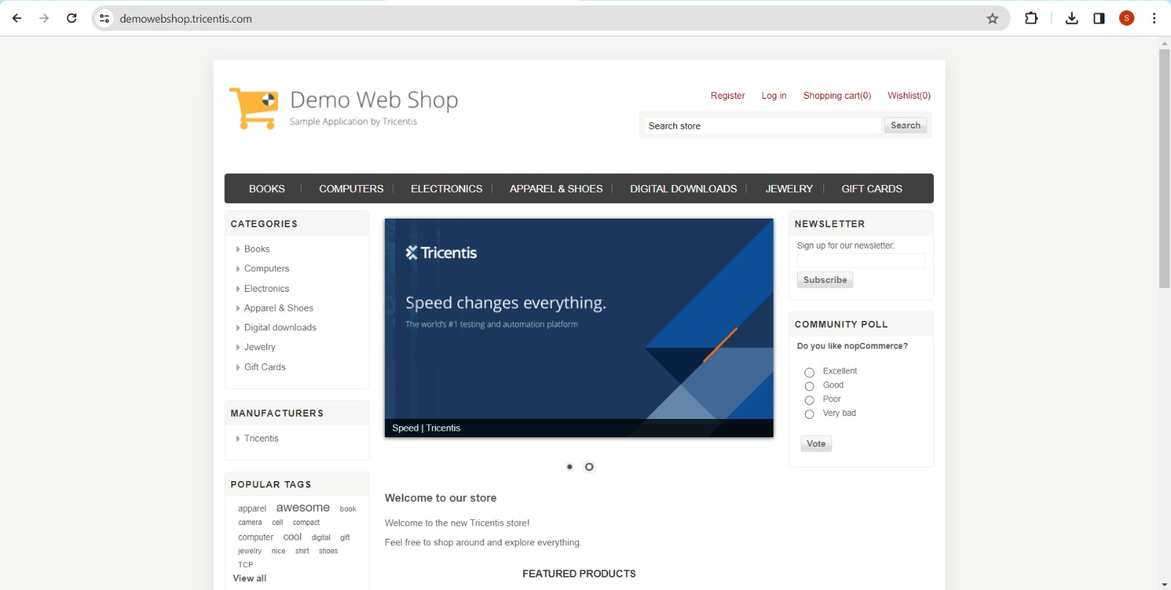

Slide 44
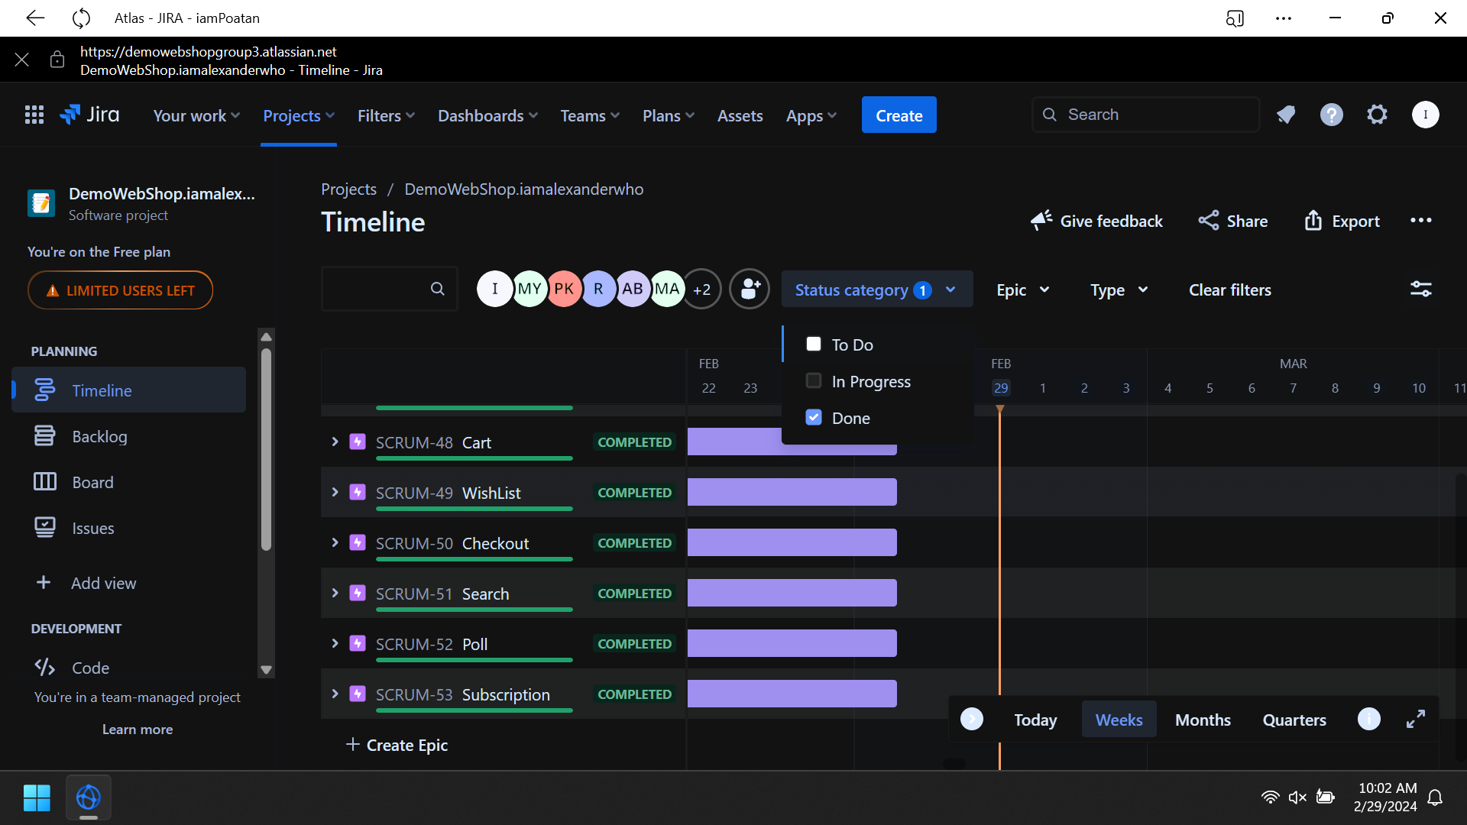

Slide 45
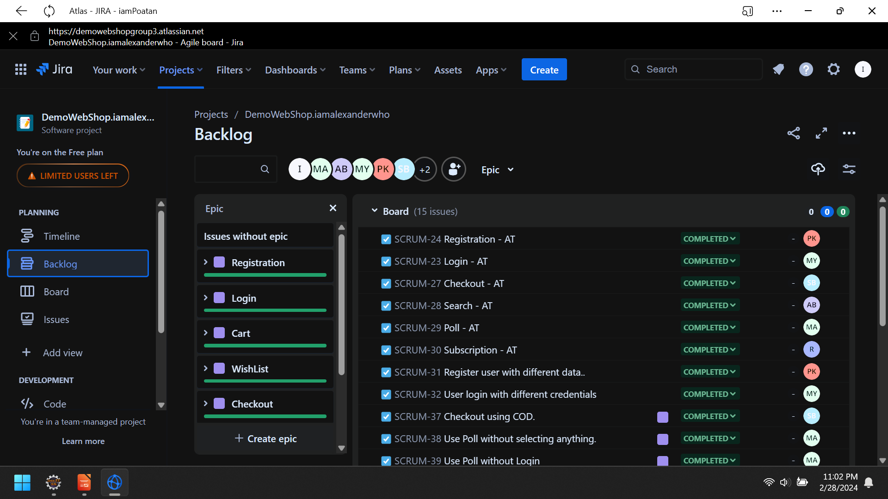

Slide 46
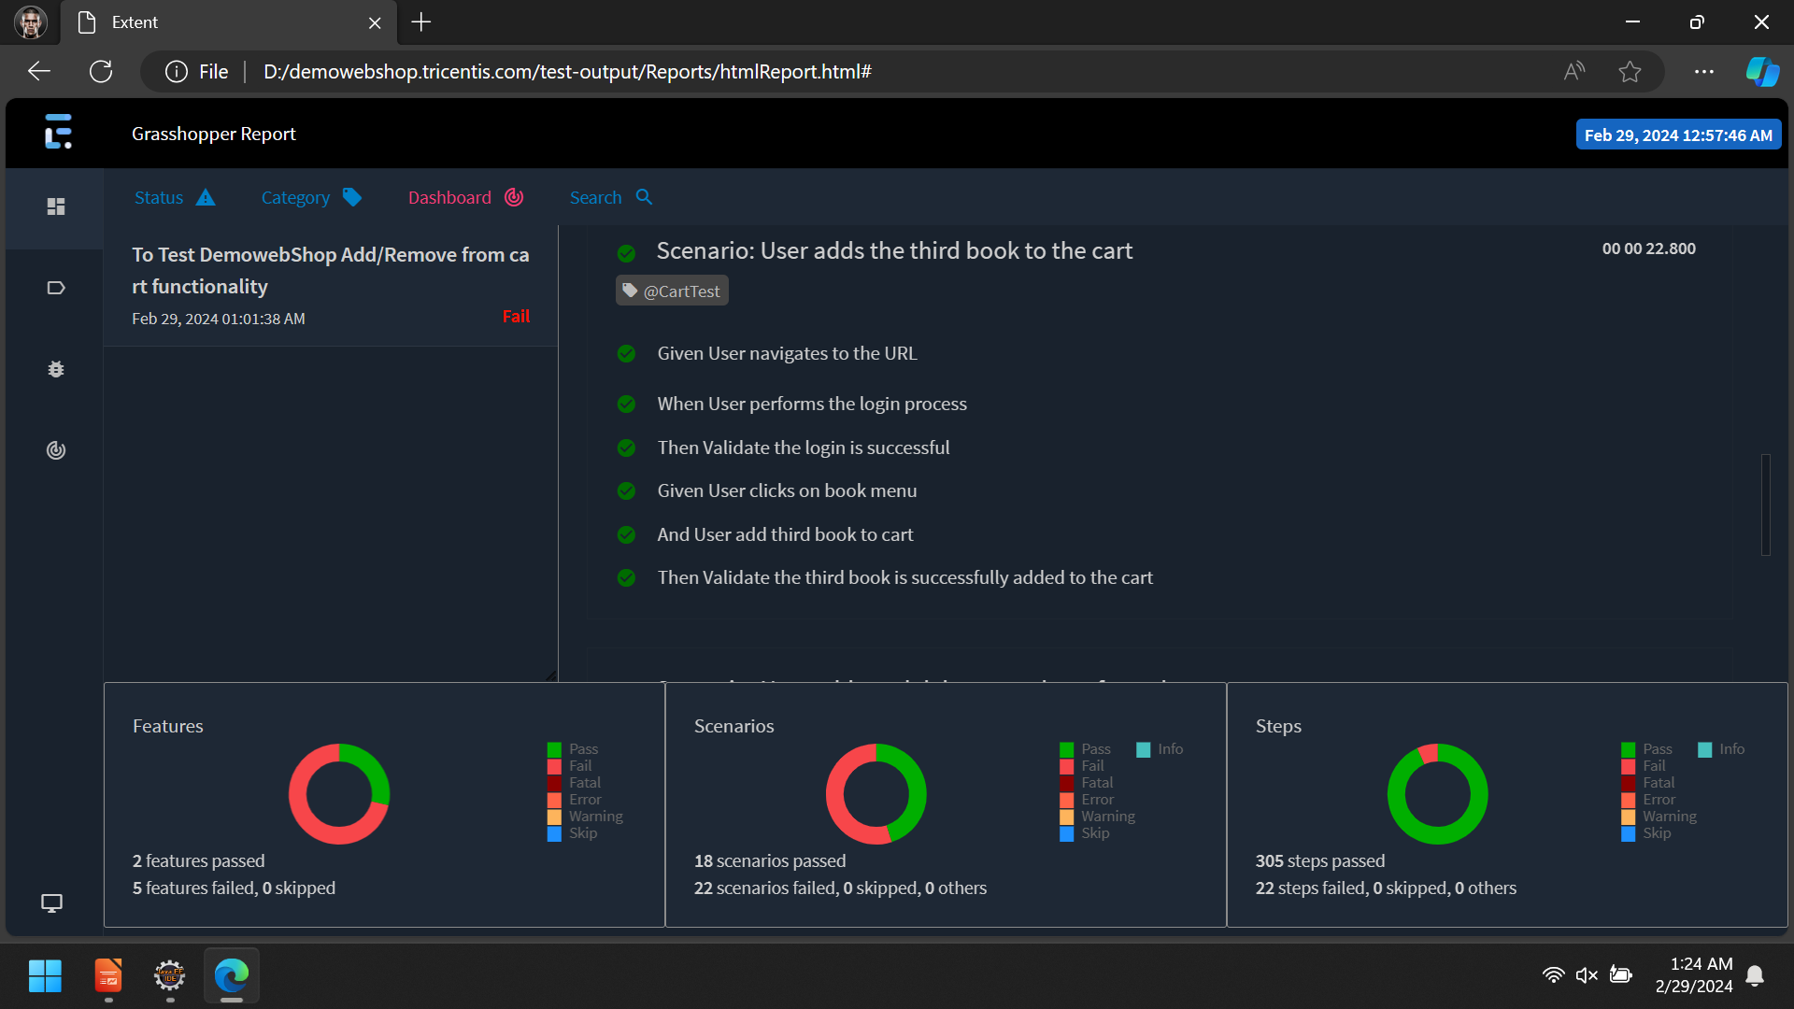

Slide 47
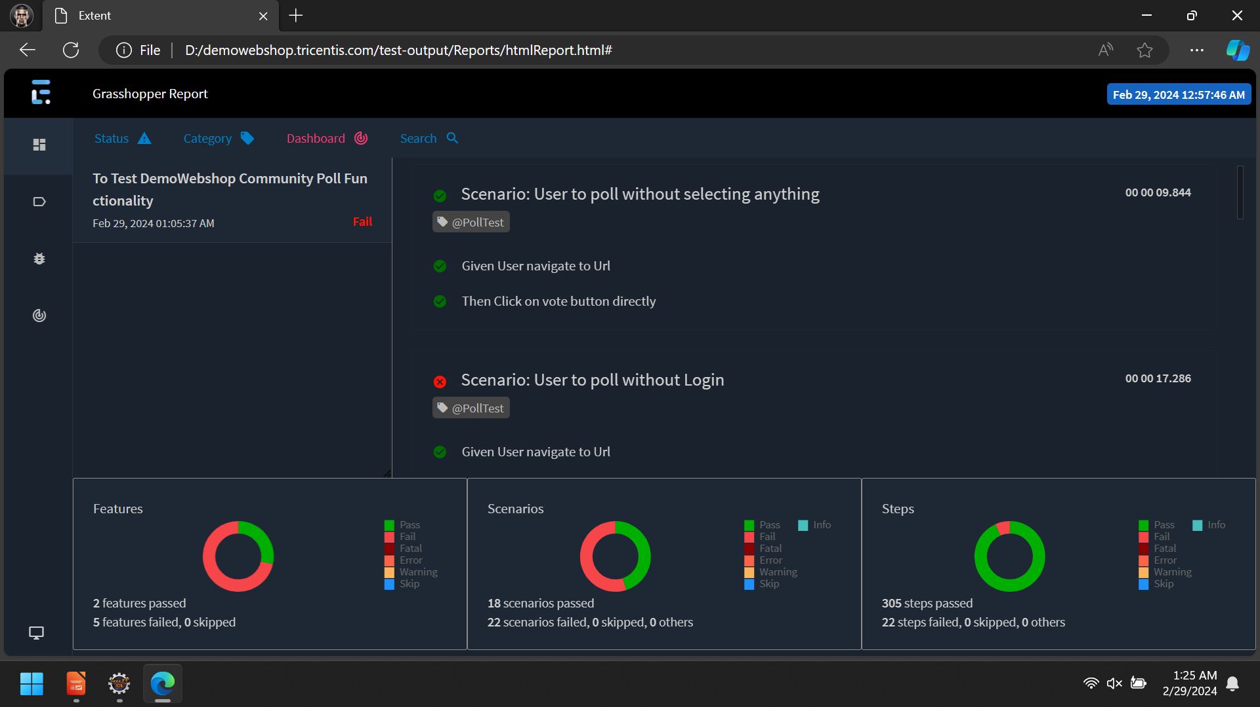

Slide 48
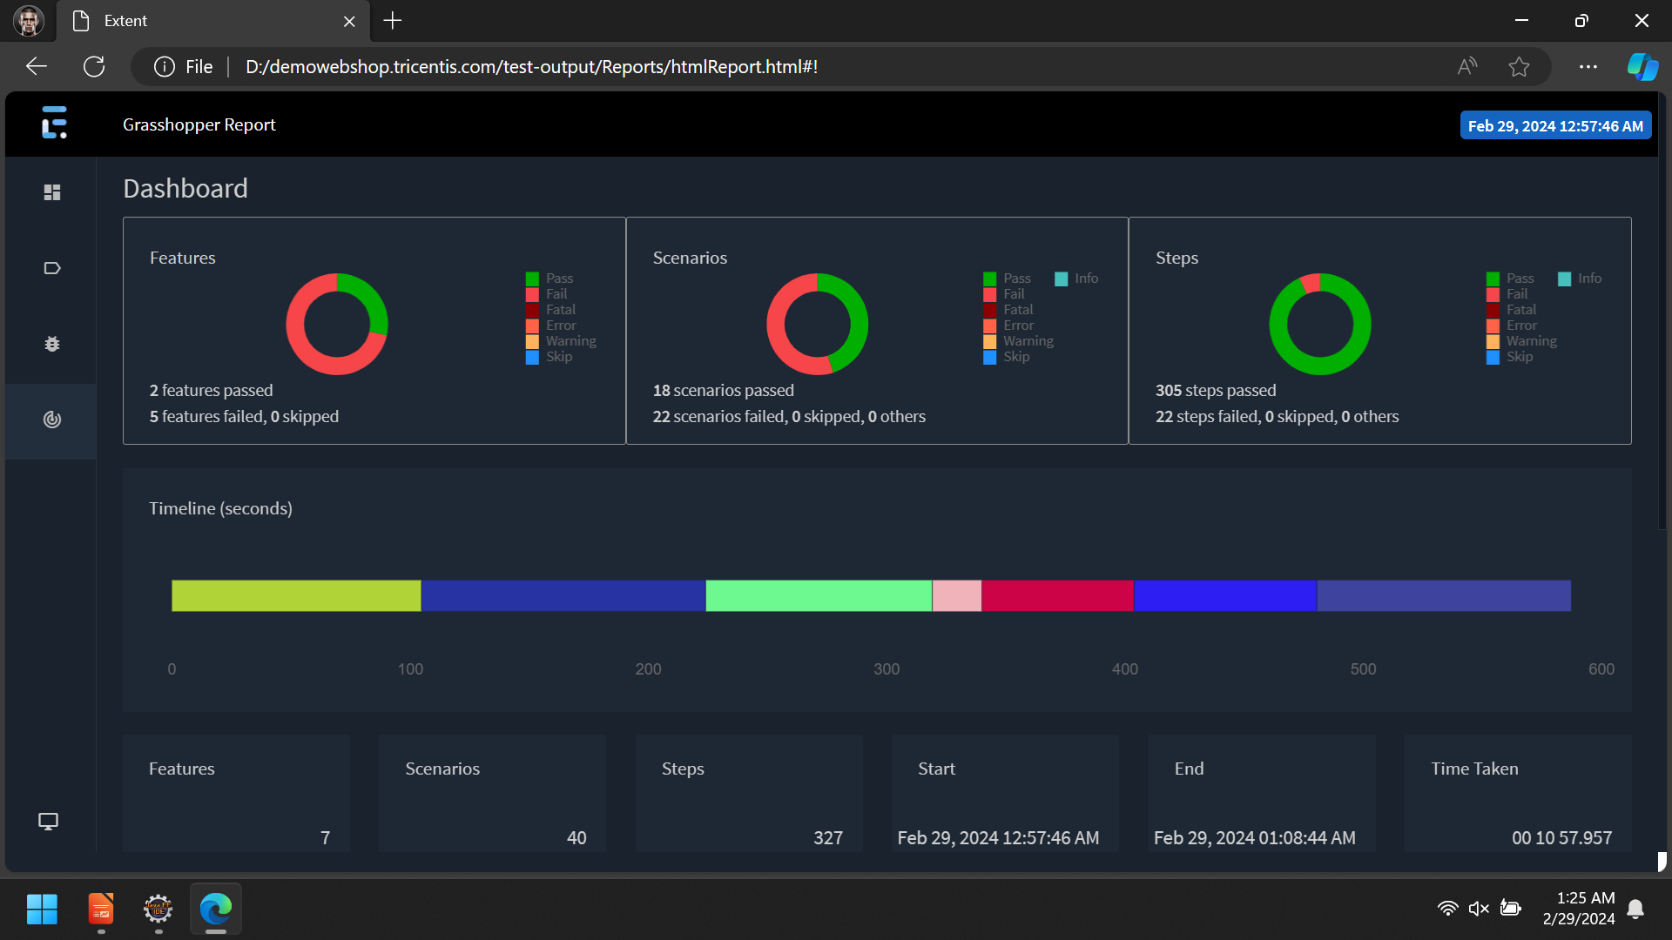

Slide 49
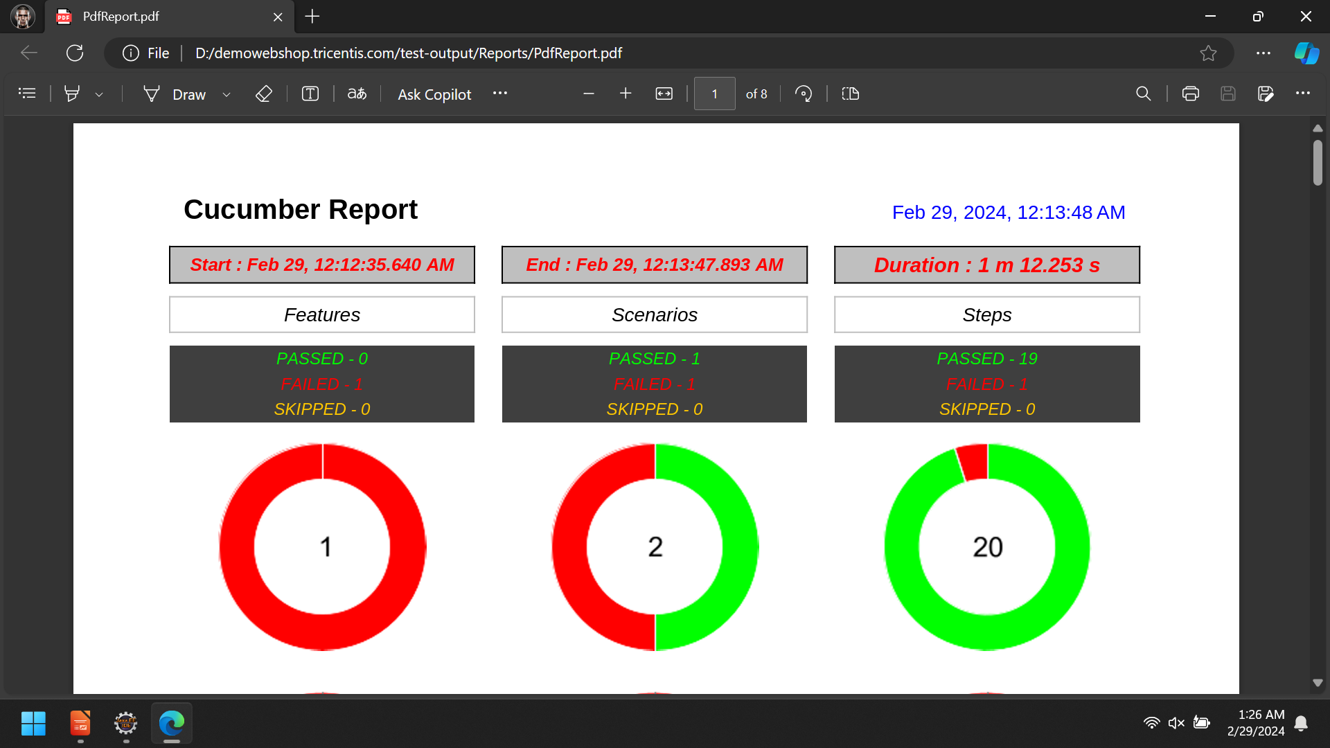

Slide 50
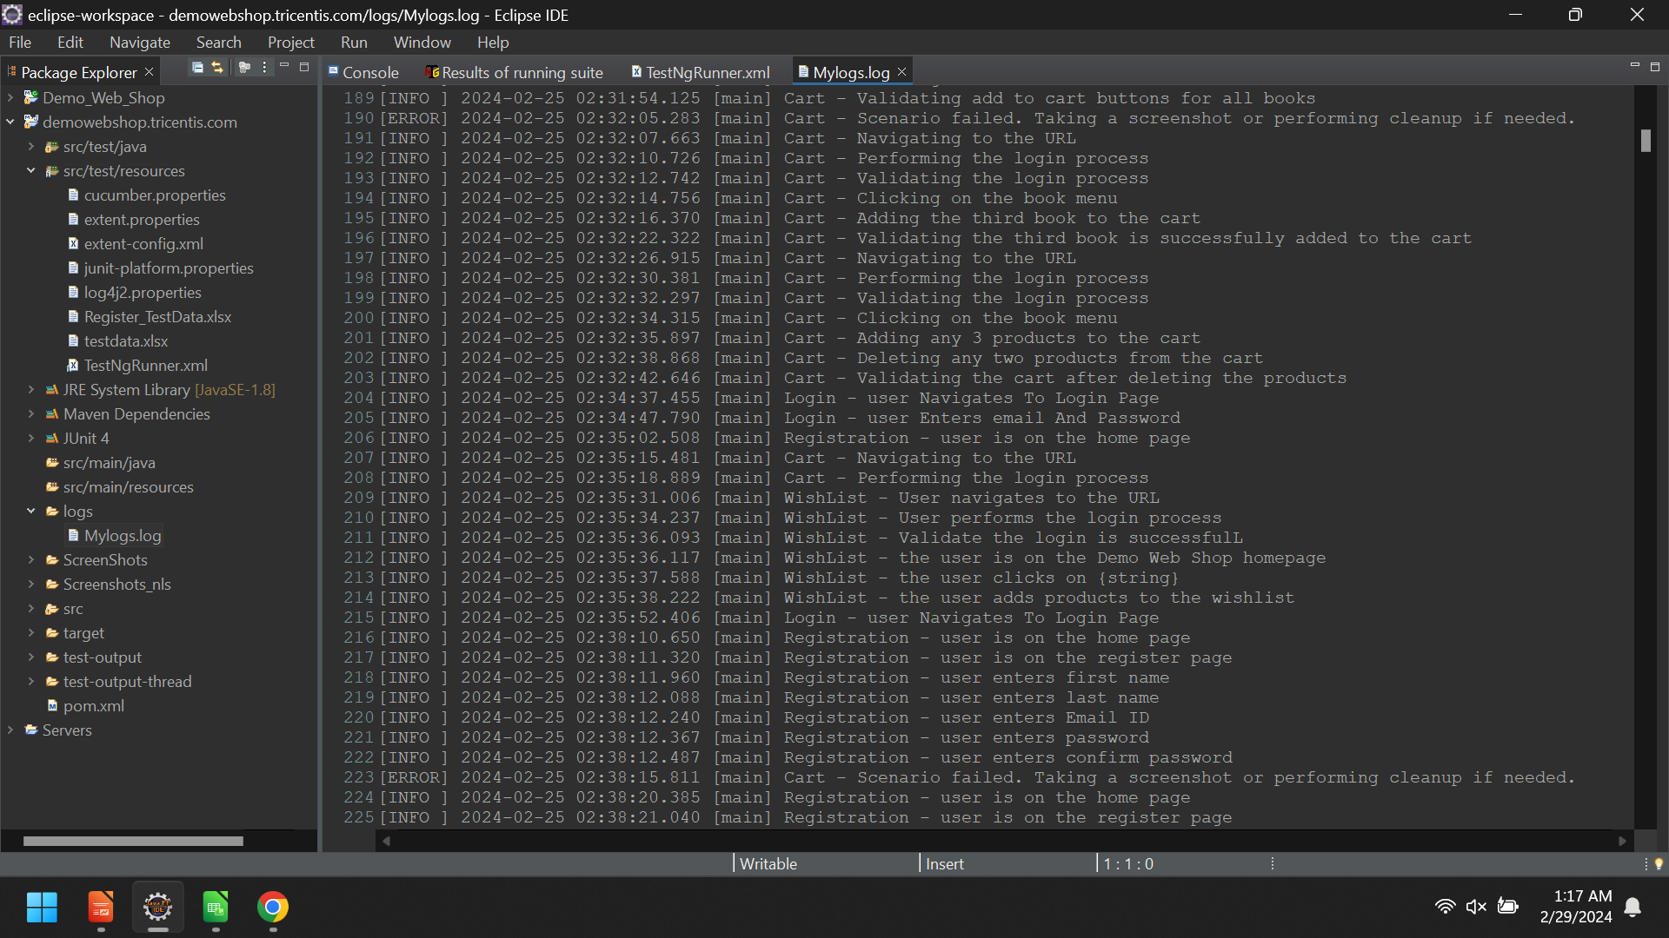

Slide 51
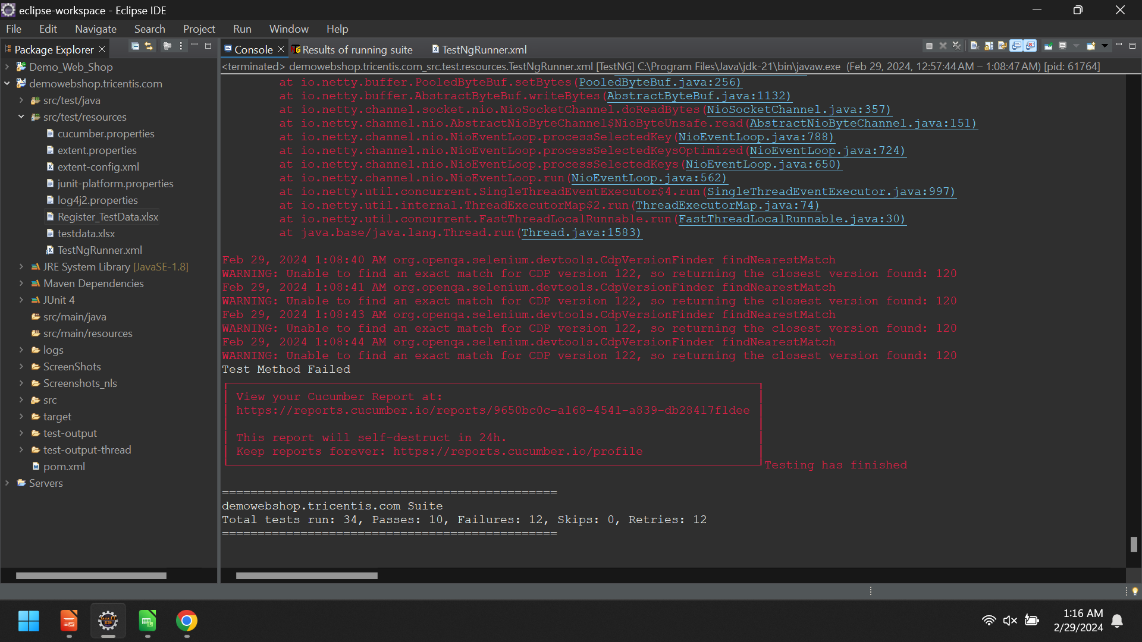

Slide 52
CONCLUSION
Quick summary of the key requirements
Hybrid Automation Framework, Five Utilities, POM Framework, Best Practices Implementation, TestNG Features (Retry, Custom Reporting), Jenkins Integration and JIRA for Test Management Lifecycle

Slide 53
THANK YOU

